Slide 1
Progress report
Speaker: Geng-Yun Tien
Advisor: Eric Y. Chuang
Date: 2023/11/01

Slide 2
Works
1
TP53 mutation prediction
(ResNet101, DenseNet201 and Inception-ResNet-v2)
2
Finish AACR abstract
3
Finish big lab meeting paper presentation

Slide 3
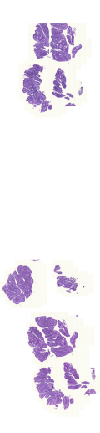
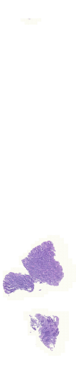
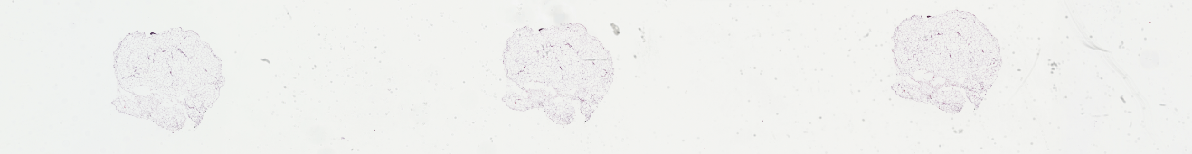
Mutation data
Original 435 WSIs are downloaded. More, exclude samples with inferior in quality (bright, blurry and inconspicuous) and the less tumor patches samples are also removed
Total 424 TCGA-COAD WSIs are used and divided into training, validation and testing set in the ratio of 70%, 10% and 20%
Generate TP53 mutation label
 | TP53
Wildtype | 222
Mutation | 202

Slide 4
Gene mutation patch-level prediction – ResNet101
TP53 | Accuracy | Sensitivity | Specificity | AUC
testing | 0.628 | 0.726 | 0.495 | 0.662
training | 0.696 | 0.79 | 0.578 | 0.767
Gene mutation slide-level prediction – ResNet101
Threshold = 0.5
TP53 | Accuracy | Sensitivity | Specificity | AUC
testing | 0.72 | 0.732 | 0.711 | 0.734
training | 0.777 | 0.816 | 0.742 | 0.847
Threshold = 0.5427
TP53 | Accuracy | Sensitivity | Specificity | AUC
testing | 0.663 | 0.537 | 0.778 | 0.734
training | 0.787 | 0.723 | 0.845 | 0.847

Slide 5
Gene mutation patch-level prediction – DenseNet201
TP53 | Accuracy | Sensitivity | Specificity | AUC
testing | 0.638 | 0.745 | 0.493 | 0.679
training | 0.679 | 0.79 | 0.539 | 0.743
Gene mutation slide-level prediction – DenseNet201
Threshold = 0.5
TP53 | Accuracy | Sensitivity | Specificity | AUC
testing | 0.698 | 0.732 | 0.667 | 0.752
training | 0.743 | 0.816 | 0.677 | 0.831
Threshold = 0.5223
TP53 | Accuracy | Sensitivity | Specificity | AUC
testing | 0.698 | 0.683 | 0.711 | 0.752
training | 0.767 | 0.773 | 0.761 | 0.831

Slide 6
Gene mutation patch-level prediction – Inception-ResNet-v2
TP53 | Accuracy | Sensitivity | Specificity | AUC
testing | 0.622 | 0.73 | 0.476 | 0.66
training | 0.654 | 0.771 | 0.507 | 0.708
Gene mutation slide-level prediction – Inception-ResNet-v2
Threshold = 0.5
TP53 | Accuracy | Sensitivity | Specificity | AUC
testing | 0.663 | 0.732 | 0.6 | 0.696
training | 0.73 | 0.844 | 0.626 | 0.821
Threshold = 0.5213
TP53 | Accuracy | Sensitivity | Specificity | AUC
testing | 0.651 | 0.634 | 0.667 | 0.696
training | 0.77 | 0.794 | 0.748 | 0.821

Slide 7
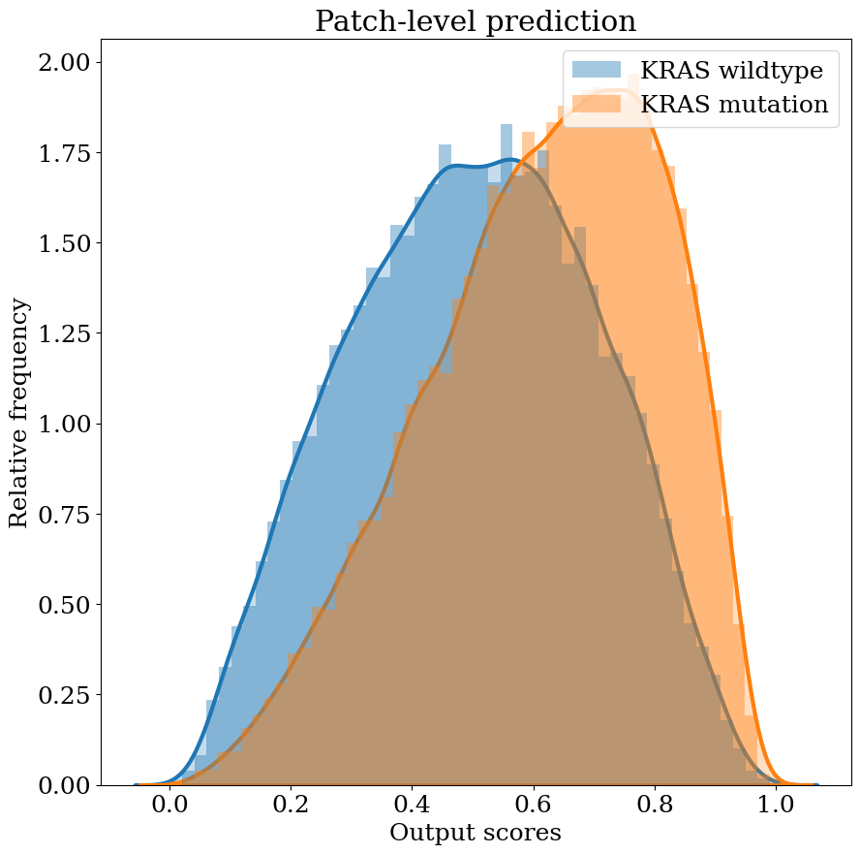
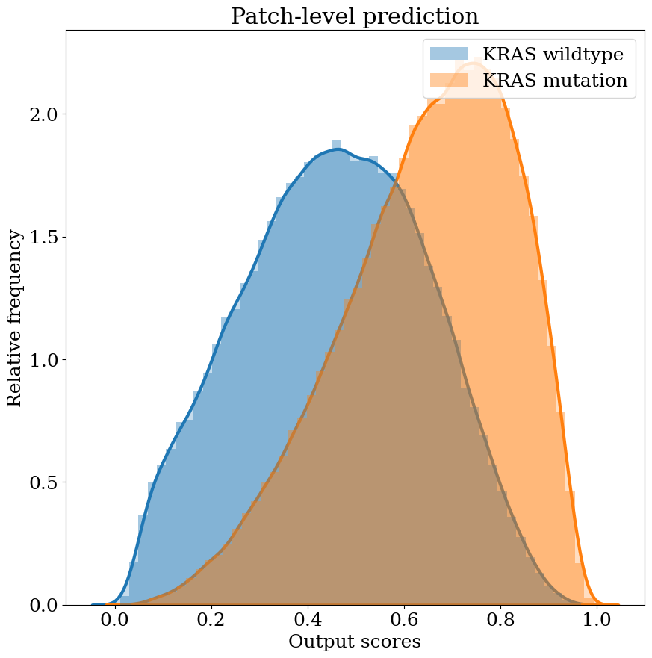
TP53 patch-level prediction ResNet101 result

Slide 8
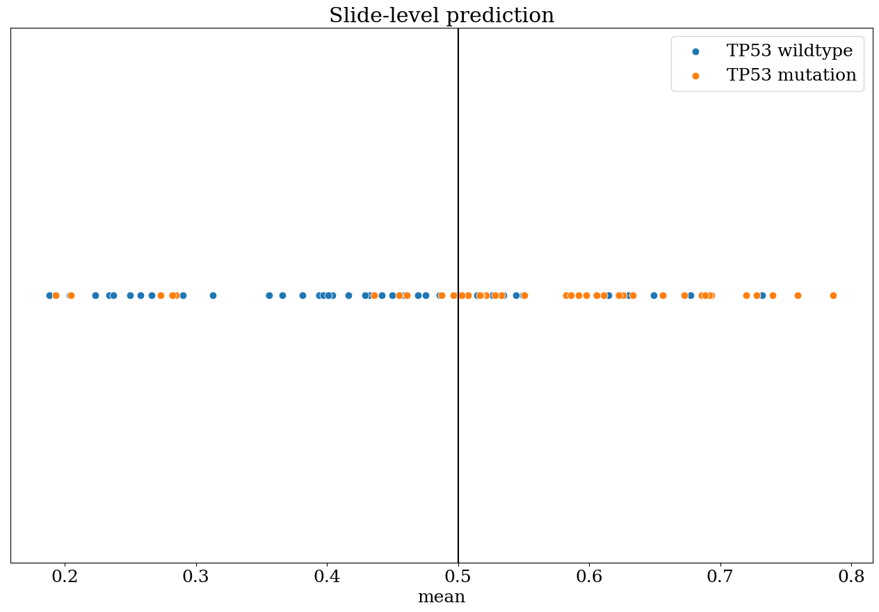
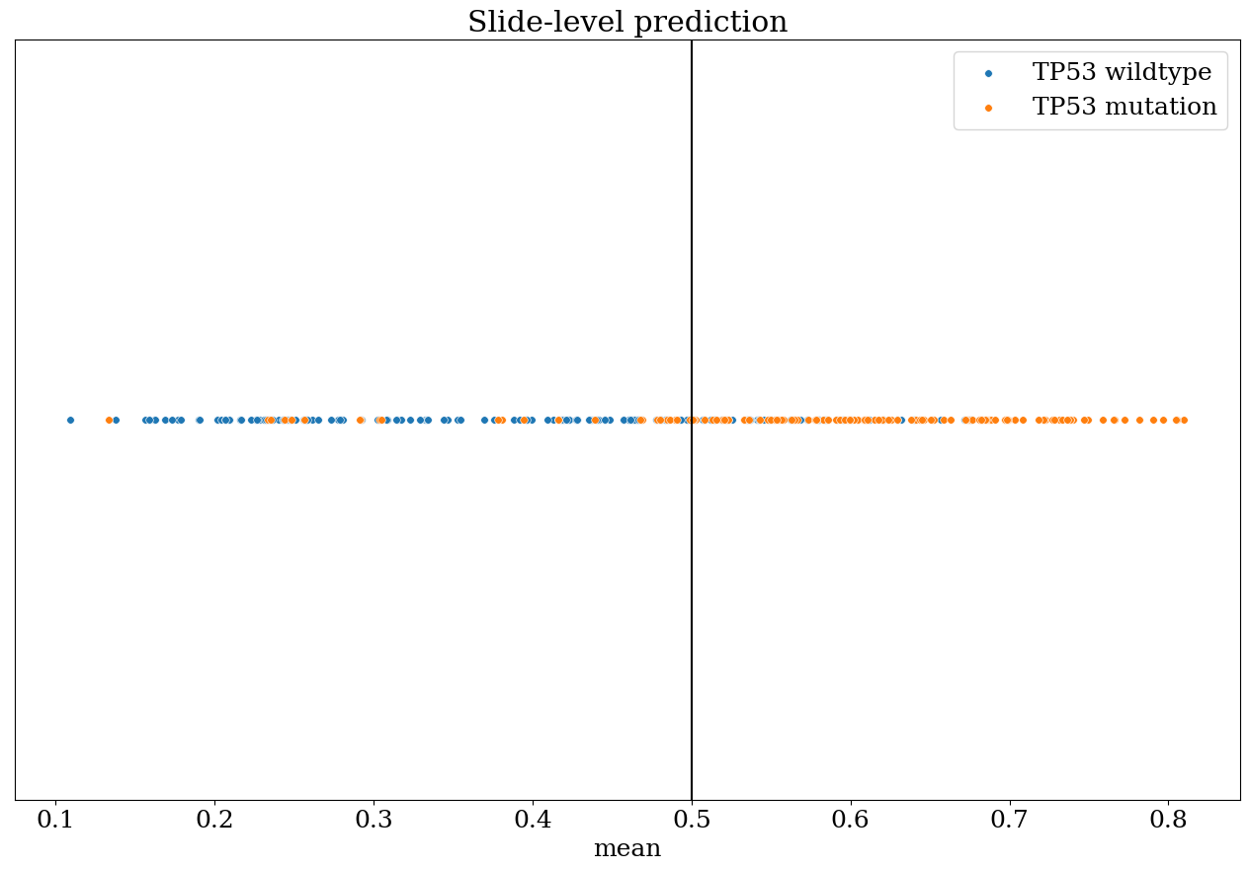
TP53 slide-level prediction ResNet101 result (threshold = 0.5)

Slide 9
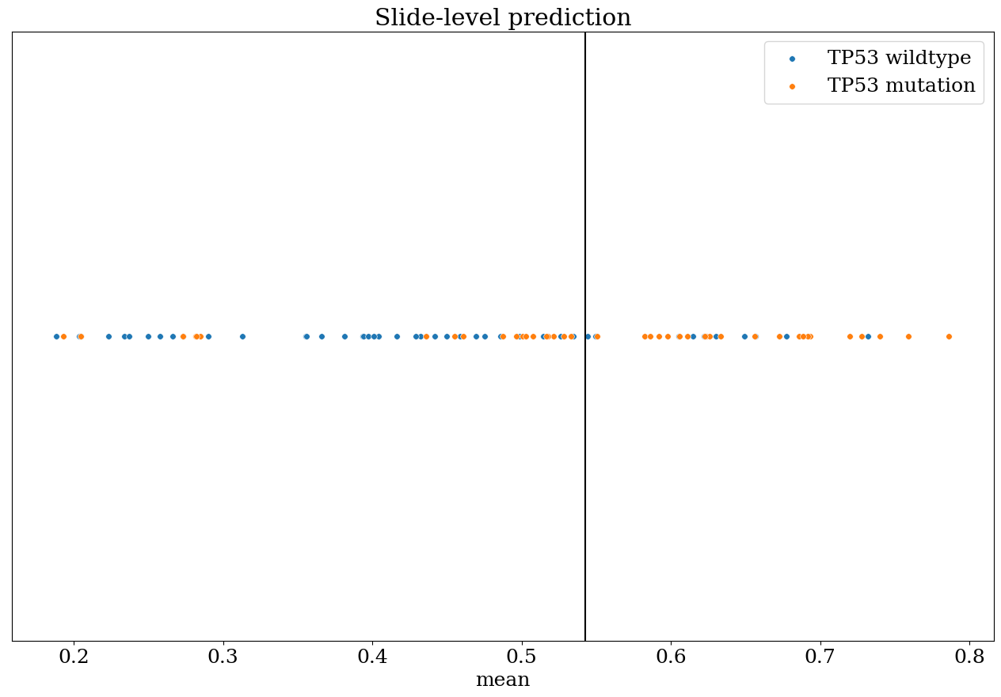
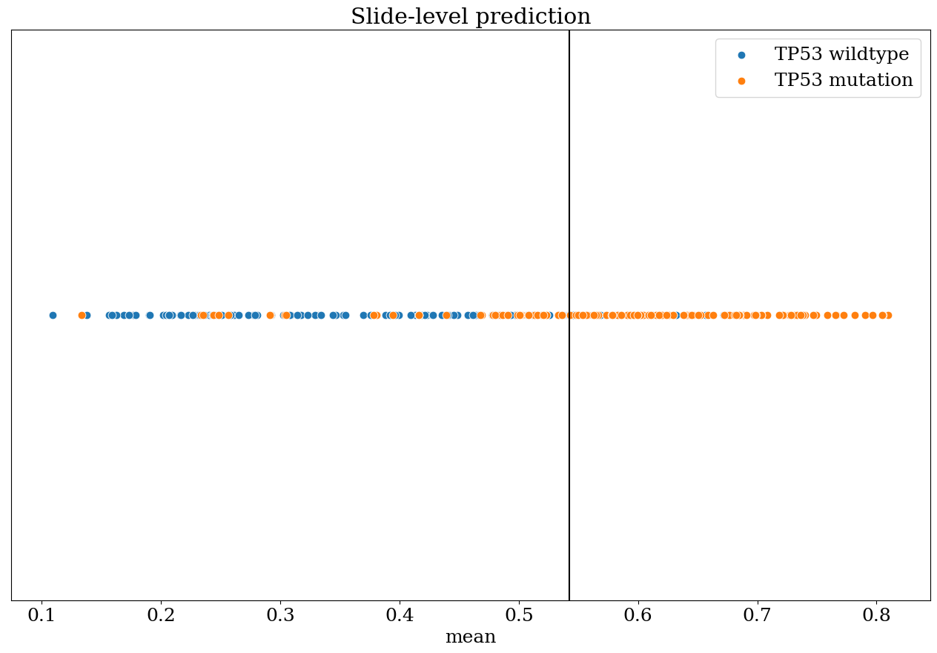
TP53 slide-level prediction ResNet101 result (threshold = 0.5427)

Slide 10
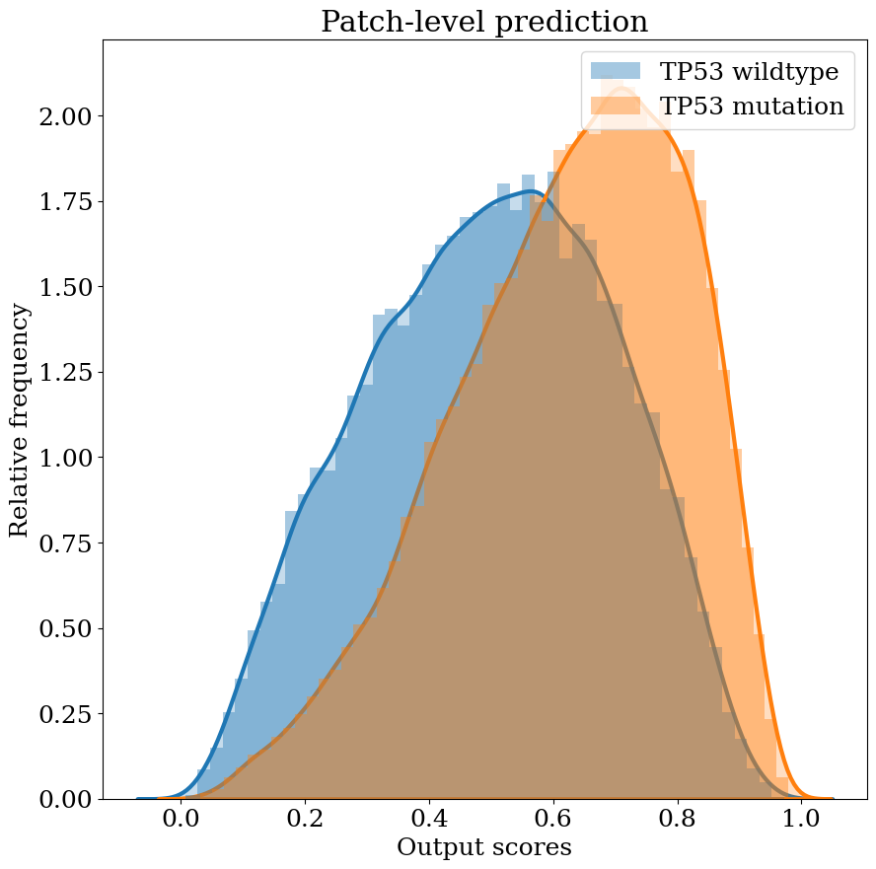
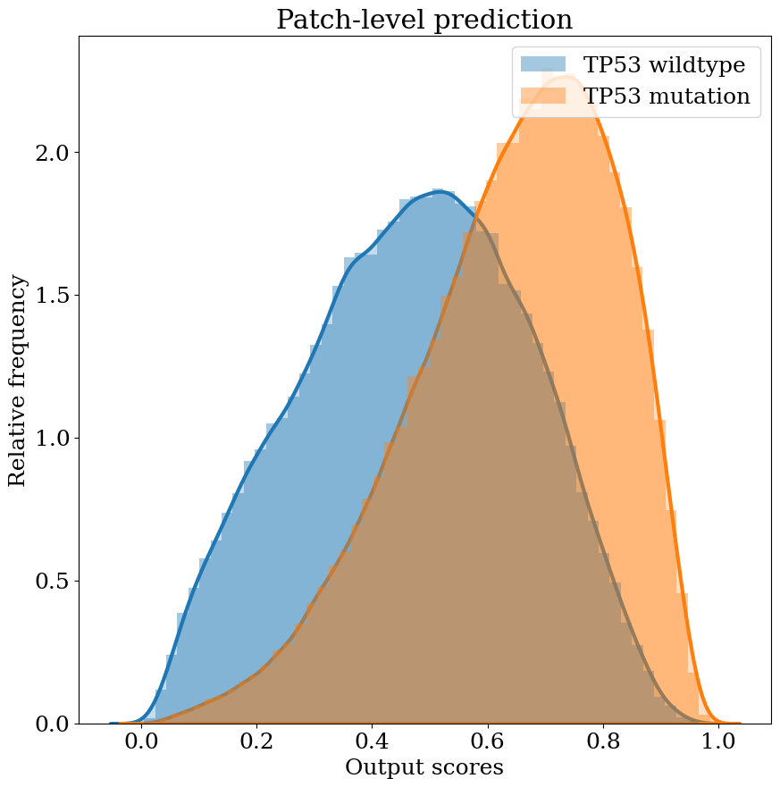
TP53 patch-level prediction DenseNet201 result

Slide 11
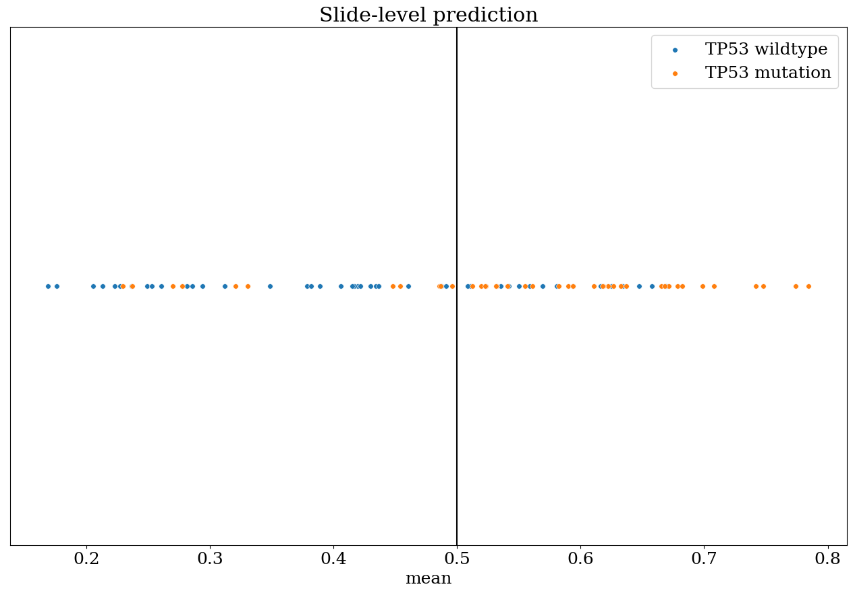
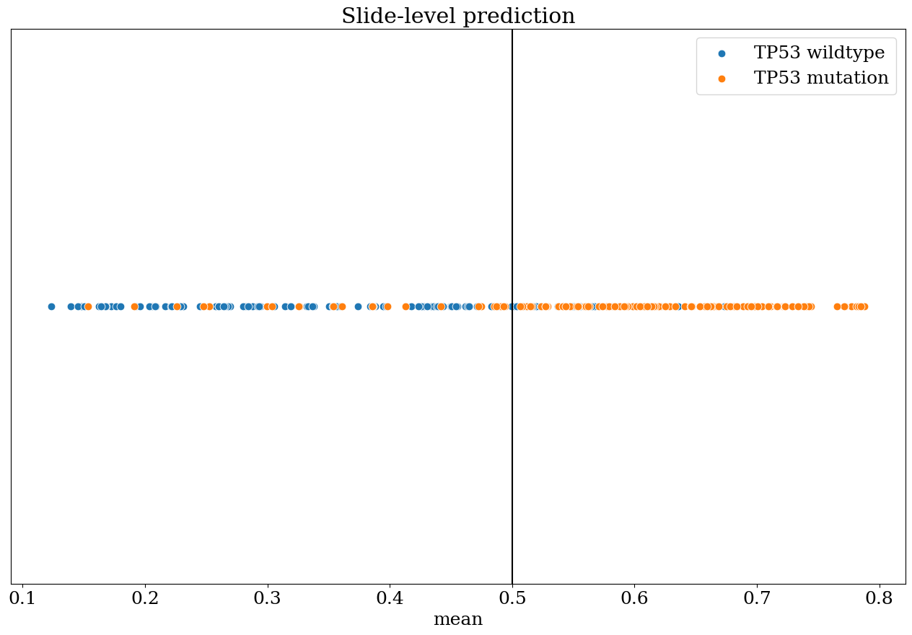
TP53 slide-level prediction DenseNet201 result (threshold = 0.5)

Slide 12
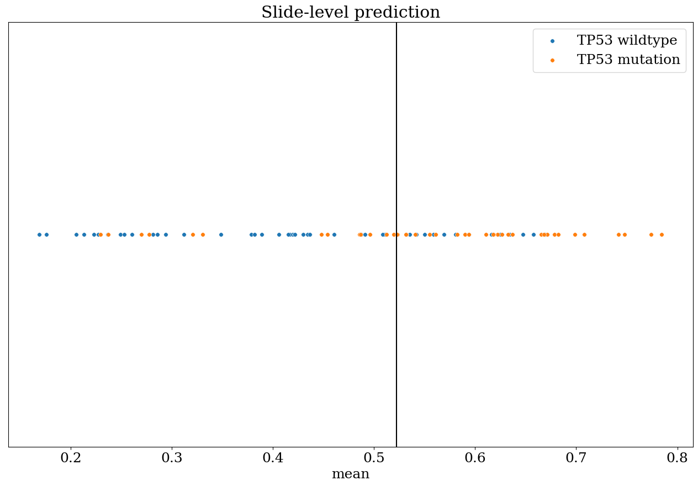
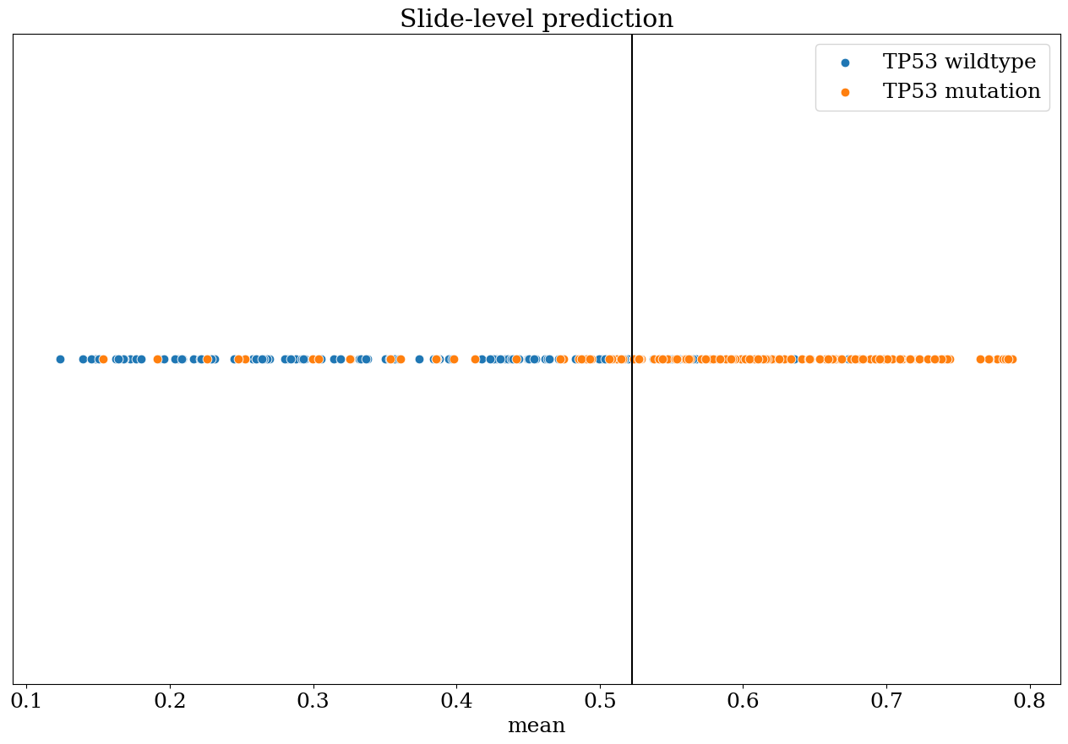
TP53 slide-level prediction DenseNet201 result (threshold = 0.5223)

Slide 13
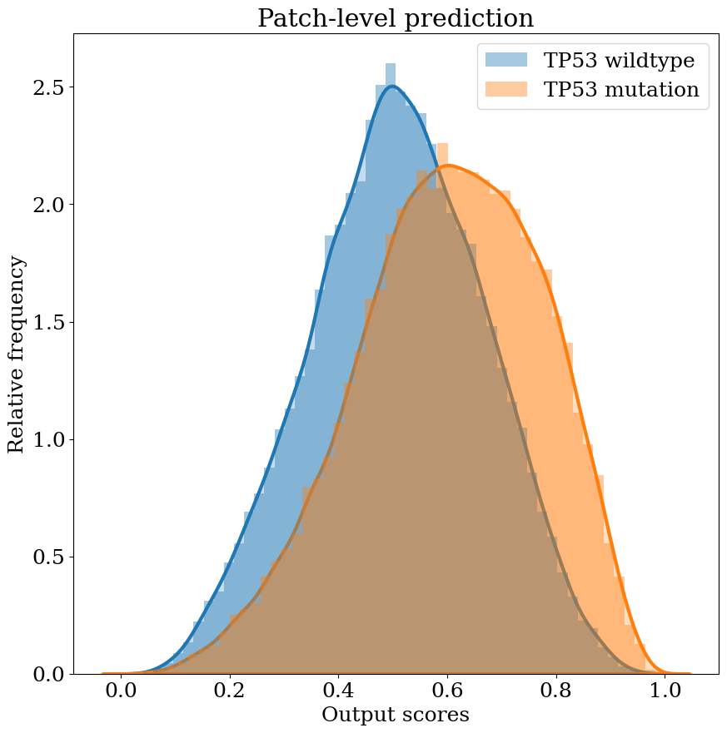
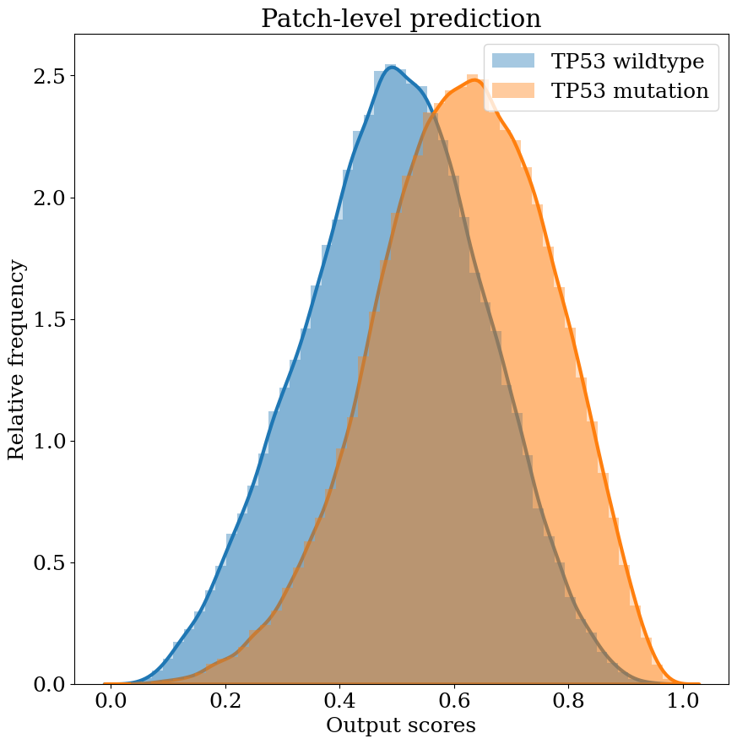
TP53 patch-level prediction Inception-ResNet-v2 result

Slide 14
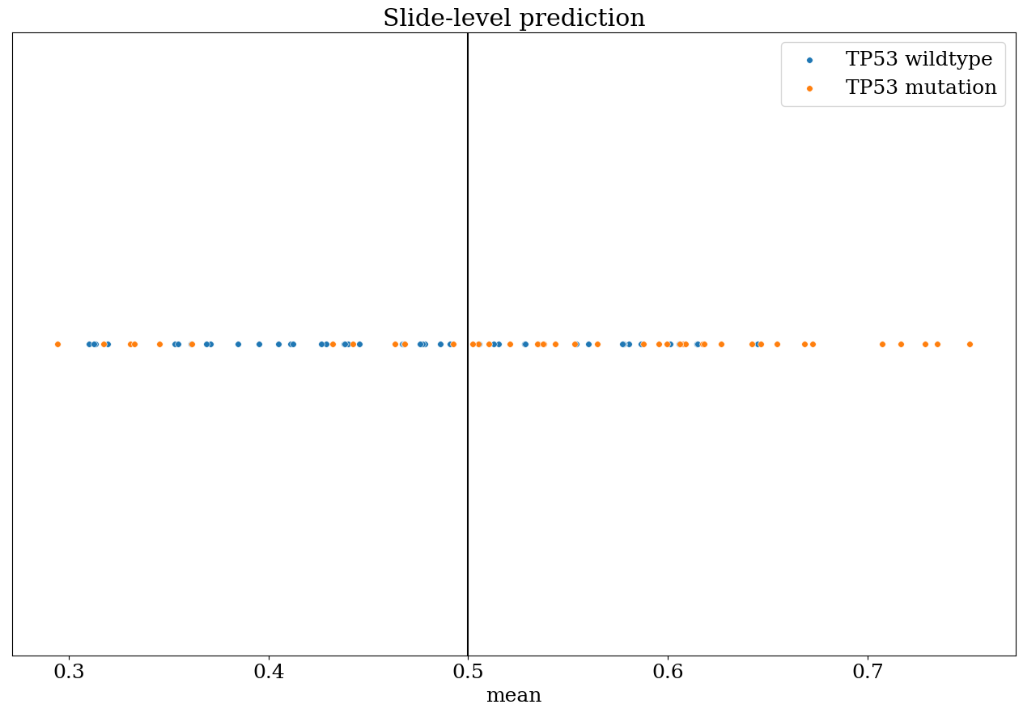
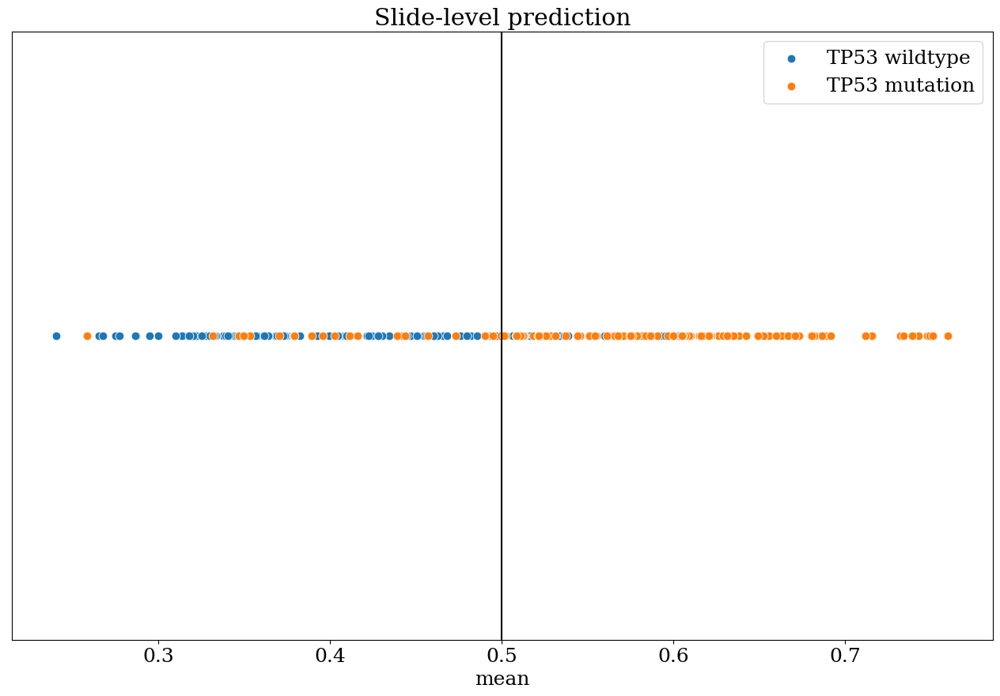
TP53 slide-level prediction Inception-ResNet-v2 result (threshold = 0.5)

Slide 15
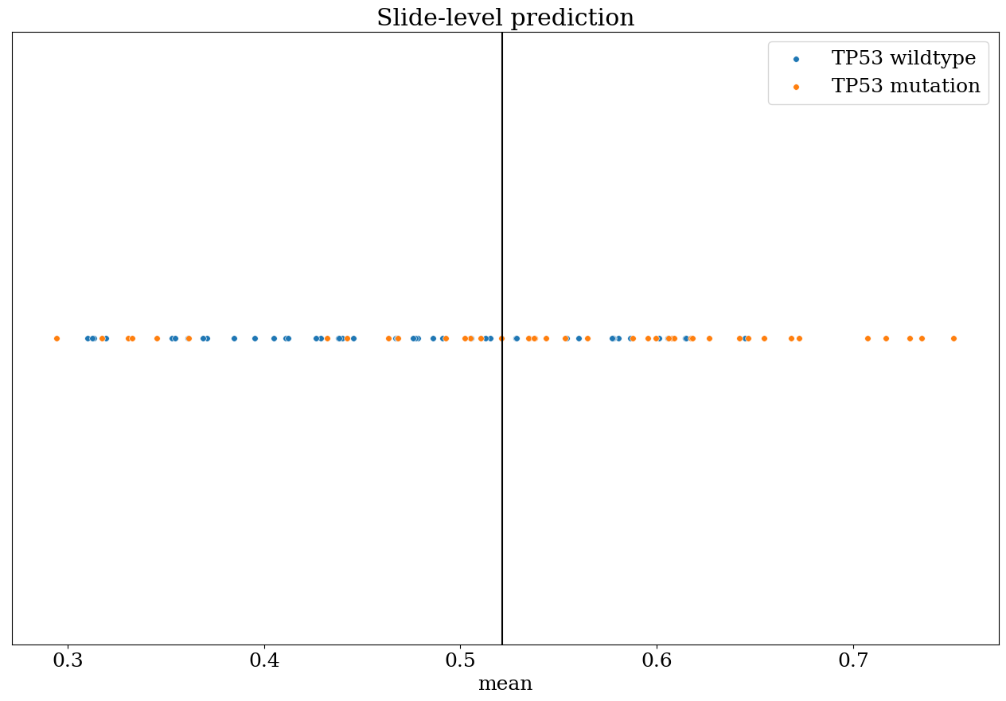
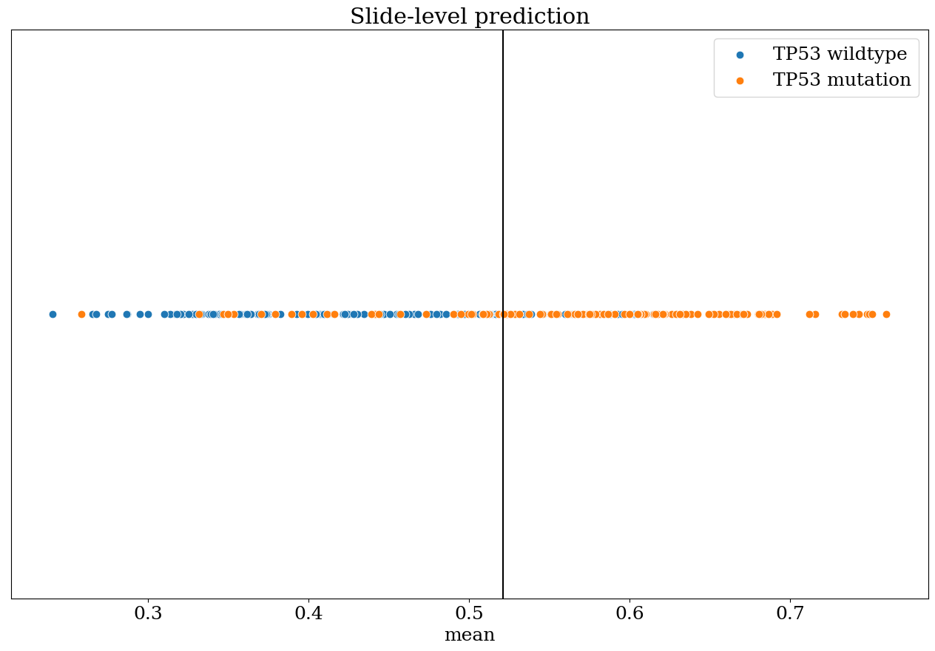
TP53 slide-level prediction Inception-ResNet-v2 result (threshold = 0.5213)

Slide 16
Future work
1
cBioPortal
2
Keep improving CNN model performance and predict other genes
3
Train attention-based model

